Slide 1
SAP FINANCIALS Closing Activities
Overview of Optimized Purchasing Process

Slide 2
Closing Activities
Overview of Closing Activities
Balance Confirmation
Value Adjustments
Regrouping
Financial Statement Versions
FI Year End Reports
Important FI tables

Slide 3
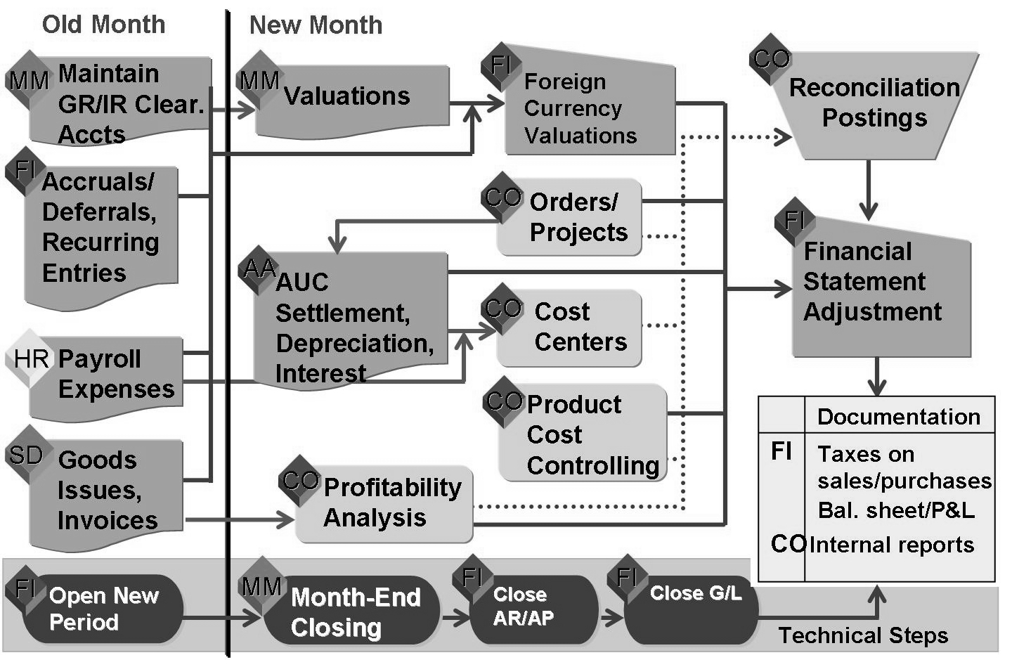
Month-End Closing Process
Pre-closing activities that begin in the old month include:
Technical - Open new accounting period (FI),
FI - Enter accruals/deferrals, process recurring entries and bad debt expense in AR, post depreciation and interest expenses in Asset Accounting
MM - Maintain GR/IR clearing account, post material revaluations
HR - Post payroll expenses
SD - Post goods issues for deliveries to customers
Technical - Close old month in (MM), close sub-ledgers
(FI), preliminary close of G/L (FI)
Closing activities for external purposes include:
CO - Reconciliation posting to FI (for cross-organizational unit CO postings)
FI - Foreign currency valuations and financial statement adjustments
Technical - Final closing of the old period
FI/CO - Creating external and internal reports

Slide 4
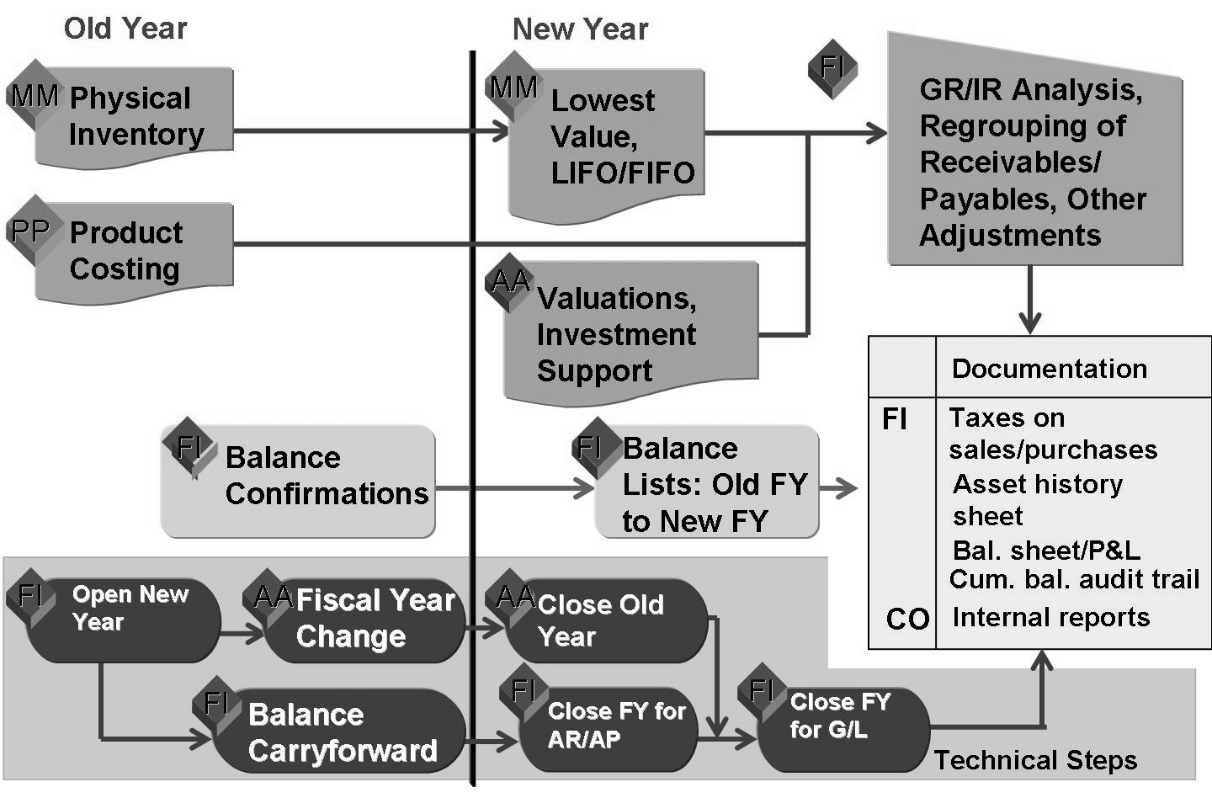
Year-End Closing Process
Pre-closing activities that begin in the old month include:
Technical . Open the first accounting period of the new fiscal year (FI),
MM - Perform physical inventory count (may be performed on up to a monthly basis)
PP/CO - Update product cost estimates (may be performed more frequently)
MM - Lowest value determination and LIFO/FIFO valuation
AA - Asset valuations and investment support
FI - Balance confirmations for customers/vendors
Technical - Fiscal year change (AA) and balance carry forward (FI)

Slide 5
Year-End Closing Process
Closing activities for external purposes include:
FI - GR/IR clearing account analysis, receivables and payables reclassification, reconciliation of prior year to new year, and other adjustment postings.
Technical - Final closing of the old period (AR/AP and G/L).
FI/CO - Creating external and internal reports.

Slide 6
Transaction for Closing Activities
With Respect to the FI – Month End.
OB52 | Open FI Posting Periods
OB08 | Maintain Exchange Rates
FBS1 | Post Accrual / Deferral Entries
F.14 | Post Recurring Entries
F.81 | Reverse Accrual / Deferral Entries
F101 | Receivables and Payables Regrouping
F.13 | GR/IR Clearing
F.05 | Revaluation of Foreign Currency Balances
F.38 | VAT Liability
F.32 | Credit Management Missing Data
S_ALR_87012284 | P/L & Balance Sheet

Slide 7
Transaction for Closing Activities
With respect to FI – Month End.
S_ALR_87100205 | Balance Audit Trail
S_ALR_87012289 | Compact Journal
Investment Management – Monthly.
S_ALR_87013019 | Budged/Actual/Commitments
S_ALR_87012824 | Budget Availability Program
S_ALR_87012993 | Orders: Actuals/Plan/Variance
S_ALR_87012994 | Orders: Current Period / Cumulative

Slide 8
Transaction for Closing Activities
With respect to the CO: Month End.
KEAT | Reconciliation between Co/FI/SD
KE24 | Ensure Return sale order -credit memo and transfer posting tally
KO8G | Settlement of Investment Orders to AUC
KO8G | Settlement of Investment Orders to Fixed Assets
KALC | FI-CO Reconciliation
OKP1 | Period close in CO
KB61 | Correction of FI documents for wrong cost centre entries
KALC | CO-FI Reconciliation
KEU5 | CO - PA assessment
KE30 | RES1 Report execution and validation
 | Regularization of deliveries non invoiced
 | Reconciliation between CO - CCA - COPA

Slide 9
Transaction for Year End Closing Activities
With Respect to the FI – Year End.
OB52 | Open FI Posting Periods
AJRW | Fiscal Year Change for Fixed Assets
AJAB | Fixed Assets Year-End Closing
ABST2 | Account Reconciliation for Fixed Assets
F.07 | Vendors & Customers
F.16 | Balance Sheet GL
F.05 | Revaluation of Foreign Currency Balances

Slide 10
Transaction for Year End Closing Activities
With Respect to the Other modules – Year End.
OKP1 | Period close in CO
KOCF | Open FI Posting Periods
S_ALR_87013611 | Fiscal Year Change for Fixed Assets
S_ALR_87013634 | Fixed Assets Year-End Closing
S_ALR_87013635 | Account Reconciliation for Fixed Assets
S_ALR_87013625 | Vendors & Customers
S_ALR_87013019 | Budget / Actual/Commitments

Slide 11

Overview of Closing Activities
Summary
You should now be able to:
Describe the integrated process of both month-end and year-end closing

Slide 12
Closing Activities
Overview of Closing Activities
Balance Confirmation
Value Adjustments
Regrouping
Financial Statement Versions
FI Year End Reports
Important FI tables

Slide 13
Balance Confirmation
Objectives
After completing this lesson, you will be able to:
Understand the options available for configuring balance confirmations.

Slide 14
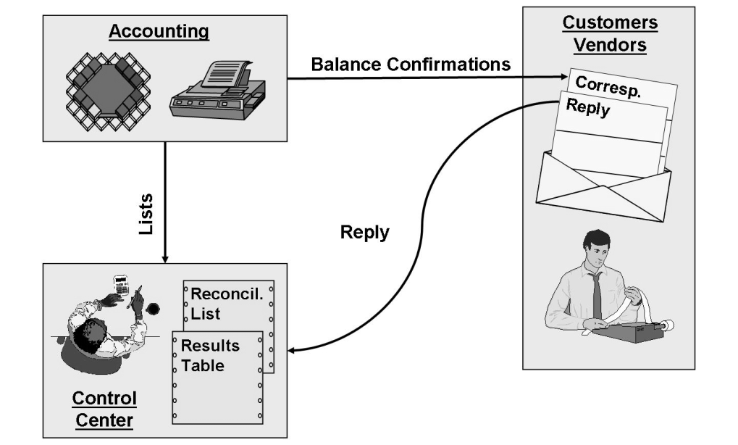
Balance Confirmations
The program for creating balance confirmations automatically creates balance confirmations (including reply slips) for a freely definable number of customers and vendors, as well as a reconciliation list and a results table.
The balance confirmations and reply slips are sent to the customers or vendors and the lists forwarded to a control center.
The customers or vendors check the balance information they receive and send their reply to the control center.

Slide 15
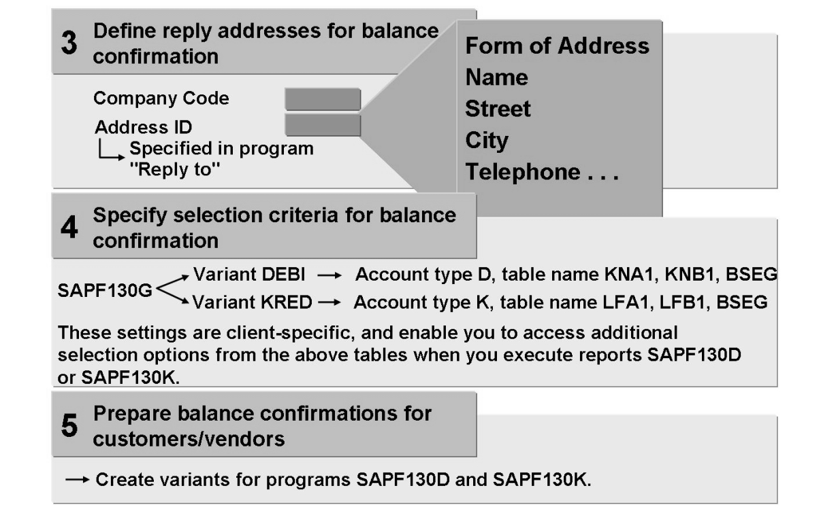
Balance Confirmations
Reports SAPF130D and SAPF130K create correspondence to and from your customers and vendors to enable you to check the balance of receivables and payables.
You must specify at least one address to which balance confirmations should be sent.

Slide 16
Balance Confirmations : Exercise Time
? Create a balance confirmation for your customer

Slide 17
Balance Confirmations
Summary
You should now be able to:
Create balance confirmations

Slide 18
Closing Activities
Overview of Closing Activities
Balance Confirmation
Value Adjustments
Regrouping
Financial Statement Versions
FI Year End Reports
Important FI tables

Slide 19
Value Adjustments
Lesson Objectives
After completing this lesson, you will be able to:
Explain how individual value adjustments are posted.
Describe flat-rate individual value adjustments for doubtful receivables.

Slide 20
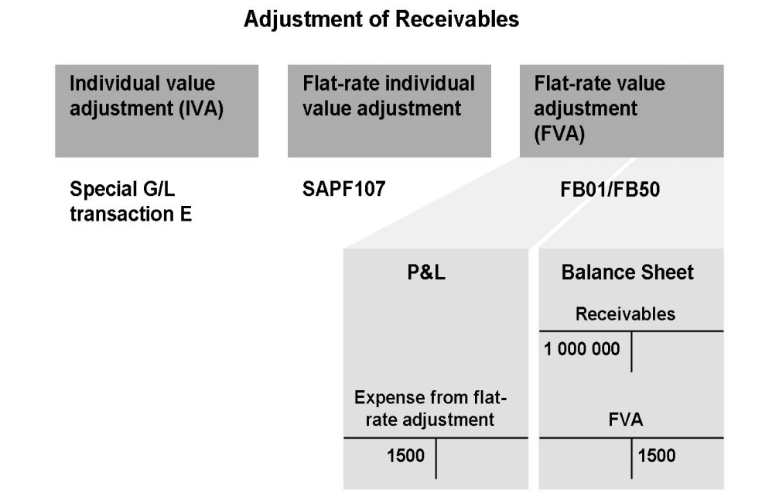
Value Adjustments
The following options are available for creating value adjustments for receivables:
You enter individual value adjustments (IVA) as a special G/L transaction E.
You use the program SAPF107 “Additional valuations” to carry out a flat-rate individual value adjustment.
Once you have determined the amount of the value adjustment, you adjust the flat-rate value by making a manual G/L account posting. The posting record is as follows: Expense from flat-rate value adjustment to value adjustment.

Slide 21
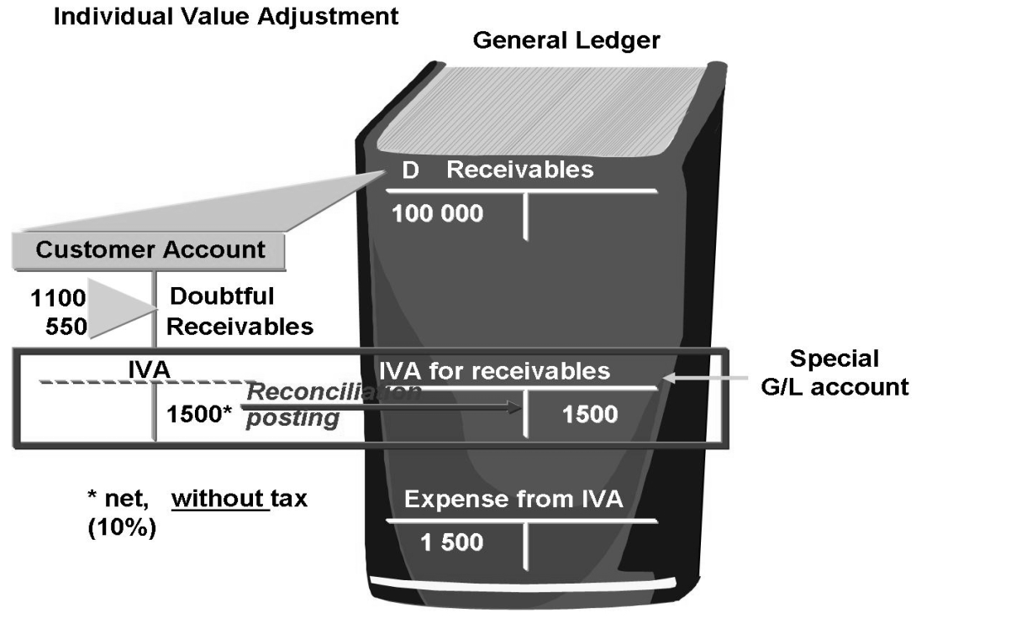
Individual Value Adjustment for Doubtful Receivables
Doubtful receivables are written off as an individual value adjustment (IVA) during year-end closing.
The special general ledger method is suitable for this procedure since the transaction is entered in the customer account and is also "posted” to a special G/L account, Individual Value Adjustments for Receivables.
After you have ascertained that the debt is irrecoverable or that the receivable has been paid, the individual value adjustment is reversed. If the debt is irrecoverable, the receivable is cleared from the customer account and the amount is posted to the account for depreciation of receivables.

Slide 22
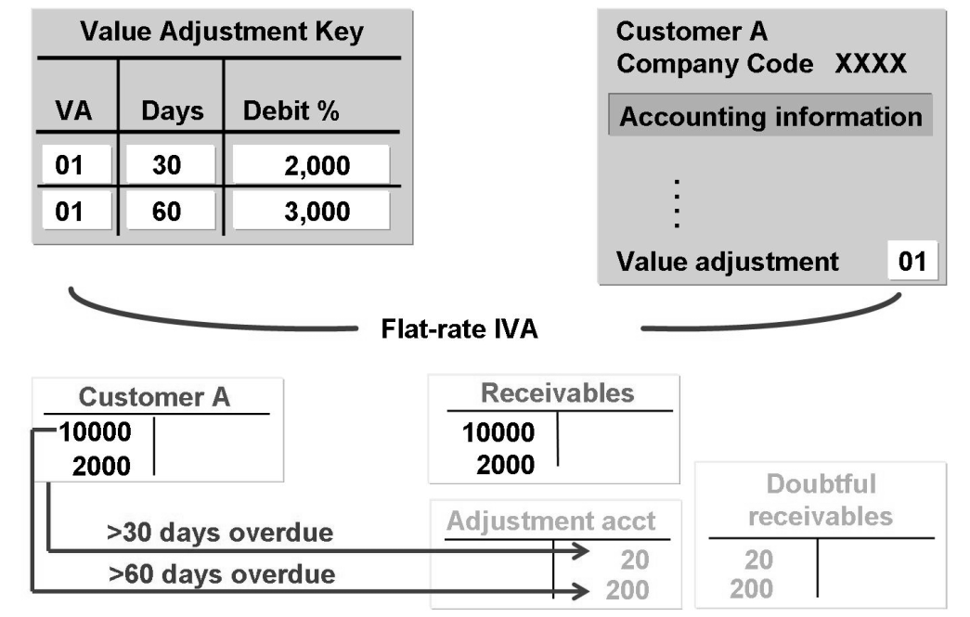
Flat-Rate Individual Value Adjustment of Overdue Receivables
In Accounts Receivable configuration, you define the debit rate percentage (bad debt expense percentage) for a valuation adjustment key and an overdue time period in days. You must also set up the appropriate adjustment and bad debt expense accounts for doubtful receivables in the account determination table.
You assign the valuation adjustment key to the master record of any customer account that you want to include in the flat-rate individual value adjustment posting.
Periodically, you carry out a valuation run to calculate the bad debt expense posting for overdue items.

Slide 23
Flat-Rate Individual Value Adjustment of Overdue Receivables
The valuation run produces a valuation proposal that you can manually change, if desired. If you agree with the proposal, you can transfer the valuation to the general ledger to generate the postings. The system then makes the adjustment posting for the relevant key date and the reversal posting for the day after the key date.

Slide 24
Value Adjustments : Exercise Time
? Execute a flat-rate individual value adjustment for your customer.

Slide 25
Value Adjustments
Summary
You should now be able to:
Explain how individual value adjustments are posted
Describe flat-rate individual value adjustments for doubtful receivables

Slide 26
Closing Activities
Overview of Closing Activities
Balance Confirmation
Value Adjustments
Regrouping
Financial Statement Versions
FI Year End Reports
Important FI tables

Slide 27
Regrouping
Objectives
After completing this lesson, you will be able to:
Regroup receivables and payables

Slide 28
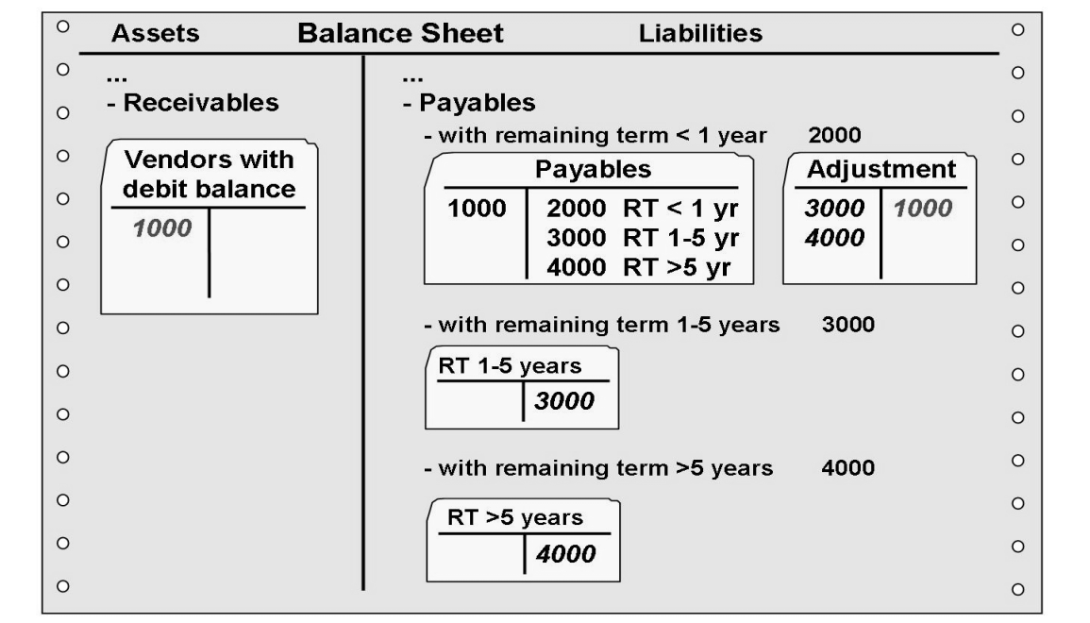
Regrouping Payables
Payables and receivables have to be listed separately in the balance sheet. Since it is possible for some vendors to have a debit balance, these balances need to be changed to customer-like vendor accounts prior to creating the financial statements.
In some countries it is also a requirement that payables are grouped in the balance sheet according to their remaining life.
Both regroupings are carried out using a special program. At the same time, these regroupings are removed for the first day of the next period, since regrouping are not necessary for daily processing.
This program is also used if the reconciliation account for a vendor was changed during the year.

Slide 29
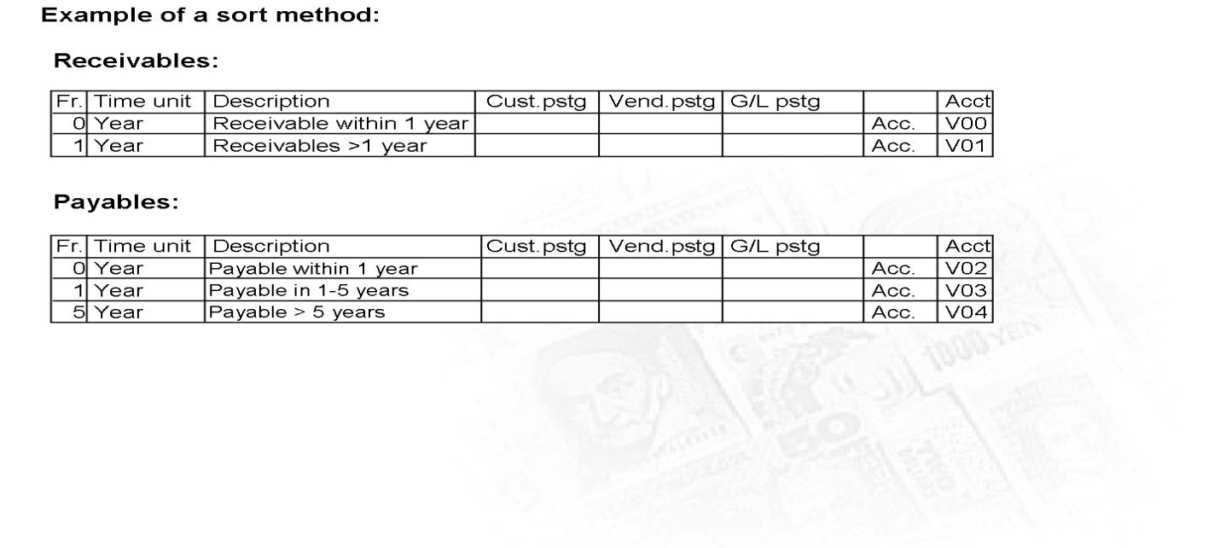
Regrouping Receivables and Payables
Before you can create financial statements, you have to group your receivables and payables according to remaining life so that they are correctly displayed in the financial statements. To do this, you have to make adjustment postings.

Slide 30
Regrouping Receivables and Payables
You can use repost SAPF101 to regroup and sort the receivables and payables; it has the following functions:
It sorts receivables and payables according to remaining life and makes the transfer postings required.
It makes the required adjustment postings (for example, for changed reconciliation accounts).
You can use report SAPF101 to determine where transfer postings are required. When you define the sort method in Customizing, you can “select” the cases where receivables and payables should be regrouped.

Slide 31
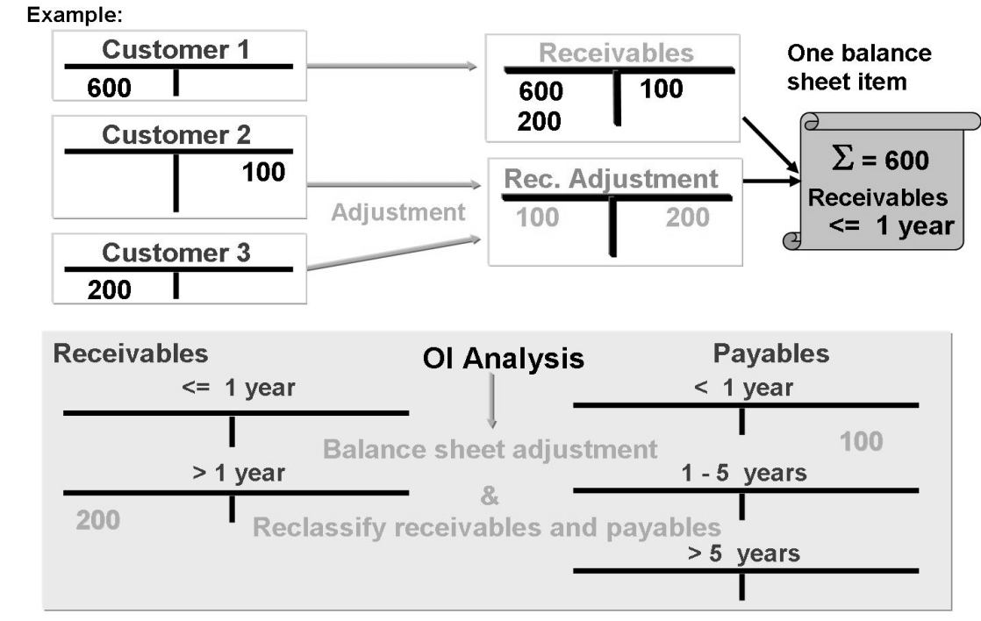
Regrouping Customers with Cr Balances/ Vendors with Dr Balances
The balance of an account determines whether the system displays it as a receivable or payable.
Receivables and payables are displayed separately according to remaining life.

Slide 32
Balancing for affiliated Companies
Your company code has receivables from and payables to a business partner that:
Is a customer as well as a vendor
Is an affiliated company(for example, company code in your group)
In the general control data in the customer and vendor master data, define the same company ID in the “Trading Partner” field.
We recommend that you define the an alternative reconciliation account in the master data(receivables from, payables to affiliated companies).
You should assign the adjustment accounts based on these special reconciliation accounts.

Slide 33
Changed Reconciliation Account (FAGL_CL_REGROUP)
You can change the reconciliation account in the customer/vendor master record during a fiscal year.
The report for performing this change displays all the receivables at the balance sheet key date using the new reconciliation account. The indicator concerned is in report FAGL_CL_REGROUP on the Other tab page.

Slide 34
Regrouping: Exercise Time
? Reclassify receivables

Slide 35
Regrouping
Summary
You should now be able to:
Regroup receivables and payables

Slide 36
Closing Activities
Overview of Closing Activities
Balance Confirmation
Value Adjustments
Regrouping
Financial Statement Versions
FI Year End Reports
Important FI tables

Slide 37
Financial Statement Versions
General Ledger accounts can be used as per legal regulations to generate the final statements. Financial statement versions are used to create the financial statements, to run account balance reports and for General Ledger accounting planning.
You can also define multiple financial statement versions to generate financial statements in different formats. Follow the steps given below to create financial statement versions

Slide 38
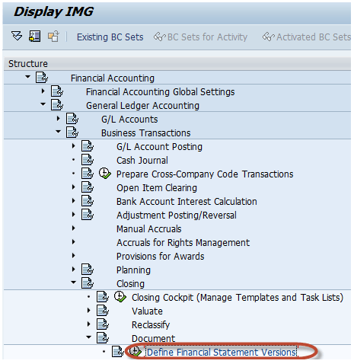

Define Financial Statement Versions
Path: SAP Customizing Implementation Guide -> Financial Accounting-> General Ledger Accounting -> Business Transactions -> Closing -> Document -> Define Financial Statement Versions
In the Next Screen, Select New Entries

Slide 39
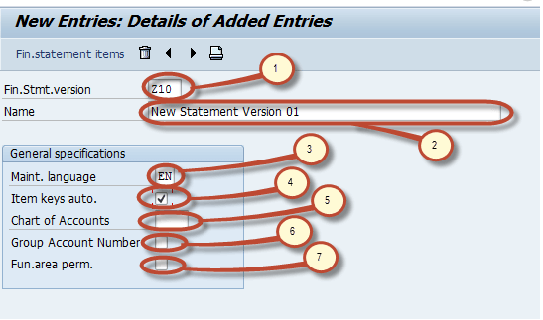
Define Financial Statement Versions
In the Next Screen, Enter the Following
Enter the FSV Key
Enter the Description for the purpose of the FSV
Enter the language key designates the language in which you Display texts, Enter texts and Print documents.
Enter this indicator which specifies whether keys of finance structure items are assigned manually or automatically when the financial statement versions are defined.
If we specify a COA here, only accounts from this chart of accounts can be assigned when you are defining the financial statement. If you do not specify a chart of accounts, accounts from several charts of accounts can be assigned when you define the financial statement.
Enter this Indicator that specifies that the group account numbers should be assigned instead of the account numbers when you define the financial statement version.
Enter this indicator as it makes possible to assign functional areas or accounts in the financial statement version.
Save the changes.

Slide 40

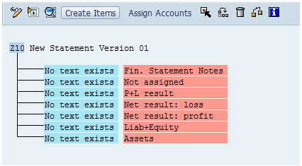
Define Financial Statement Versions
After the Financial Statement Version is saved you can edit its structure items by selecting Financial statement items button.
In the next screen, you can maintain nodes in version object A new version has seven basic nodes by default, listed below.
Financial Statement Notes
Not Assigned
P+L result
Net result : loss
Net result : profit
Liabilities + Equity
Assets

Slide 41
Define Financial Statement Versions
We can maintain node text by double clicking on the node . We can create subitems to the node by selecting the node and pressing the create items button How to create Financial Statement Version (FSV) in SAP New item will be created as sub-node to the selected node. We can assign accounts or group of Accounts to a node by selecting the node and pressing Assign Accounts.
Below is an example of such an assignment.
Primary Node "Assets"
Sub node "Cash & Cash Equivalents" are assigned to Assets ." Petty cash" is a sub-node assigned to Cash & Cash equivalents. Other nodes are also assigned to Cash & Cash Equivalents such as : Checking, Citibank Account, Mellon Bank, Citibank Canada
Chart of Account key used for assigning accounts
Range of accounts assigned to node Petty Cash
Range of Accounts

Slide 42
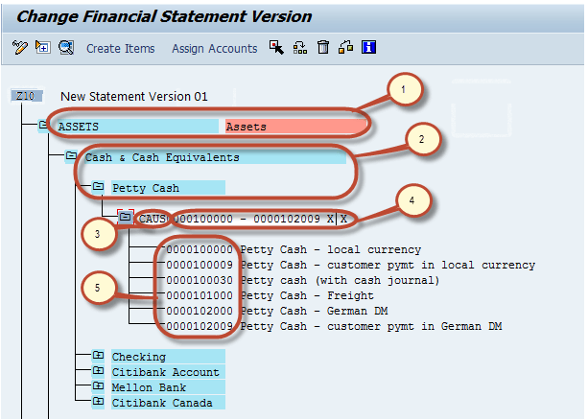
Define Financial Statement Versions
After Maintaining the structure press Save How to create Financial Statement Version (FSV) in SAP and we have successfully created a Financial Statement Version

Slide 43
Closing Activities
Overview of Closing Activities
Balance Confirmation
Value Adjustments
Regrouping
Financial Statement Versions
FI Year End Reports
Important FI tables

Slide 44
Trial balance, Profit and Loss and Balance sheet report
Structured Account Balances report
S_ALR_87012279
Profit and Loss Report
S_PL0_86000028
Actual/Actual Comparison for Year
S_ALR_87012249

Slide 45
Report S_ALR_87012279 (Structured Account Balances )
The balances of the accounts displayed in an existing financial statement version are added together in line with the version of those financial statements. The balances of the accounts are then displayed in summarized form according to the above-mentioned version.
Summarization groups are not supported by this report, but different debit are credit items for individual accounts are.
You can specify the posting periods 1 to 16 as the reporting and comparison period. The balance carried forward can be included. You also can later change the specifications for the balance carry forward and the period interval for evaluation.
Plan version/comparison year: You can choose a plan version from the reporting year or a corresponding comparison year with actual figures for comparing with the reporting year.
If you specify both, the plan version (from the reporting year) has priority.

Slide 46
Report S_ALR_87012279 (Structured Account Balances )
If you select company codes with different currencies, the system translates the balances into the currency of the first company code selected, unless you explicitly specify another currency in the currency field.
If you select company codes with the same currency and specify a different currency, this also causes the system to translate the amounts.
Steps to execute the report
Use T-Code S_ALR_87012279 and provide the following input parameters and execute
Chart of accounts
Company code
Fin.Stmt.version
Reporting year
Comparison year

Slide 47
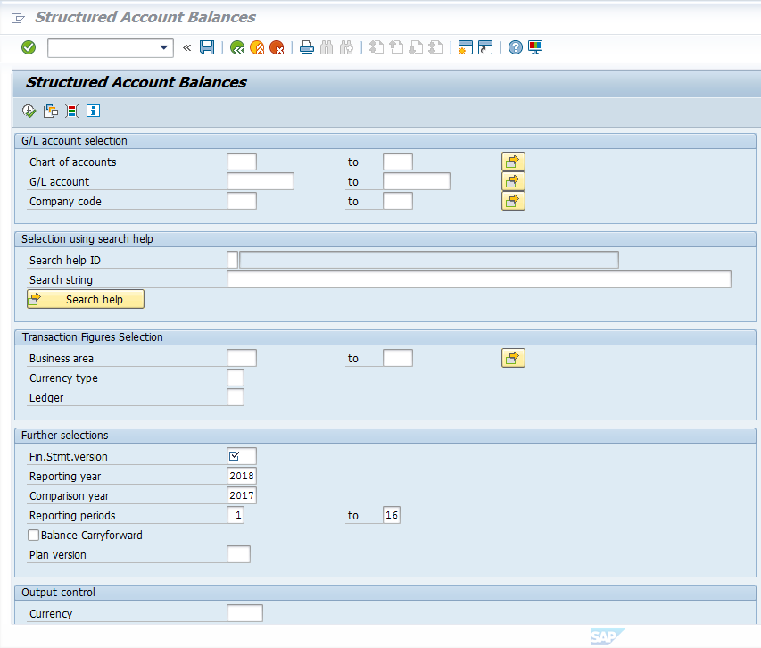
Report S_ALR_87012279 (Structured Account Balances )

Slide 48
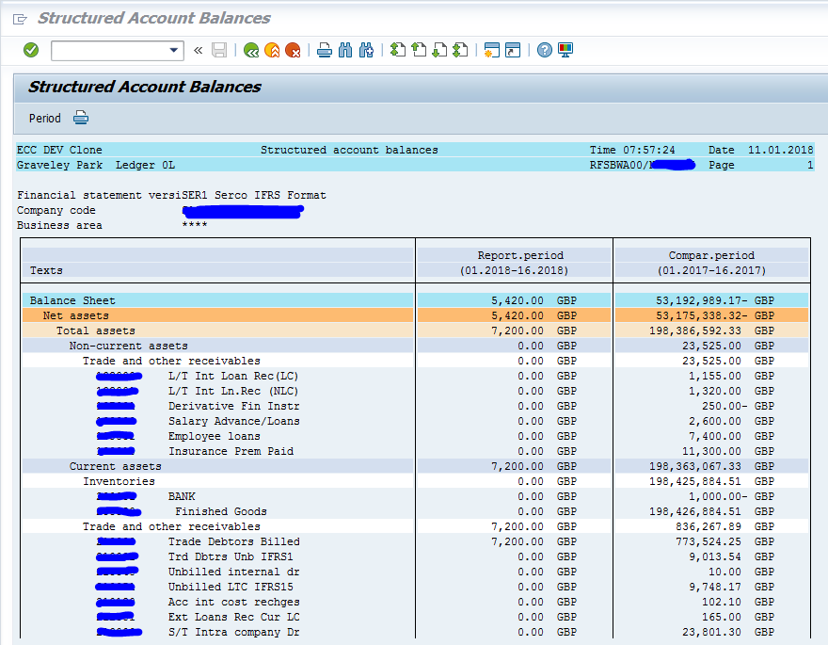
Output:

Slide 49
Report S_PL0_86000028 Financial statement :Actual/Actual Comparison for Year
Steps to execute the report
Use T-Code S_PL0_86000028 and hit enter key.
Provide the following input parameters and execute the report to view the details
Currency type
Company code
FIS annual rep. Structure
Ledger
Reporting Year
Reporting Period form
Reporting Period to
Comparison Year
Comparison Per. from
Comparison Period to

Slide 50
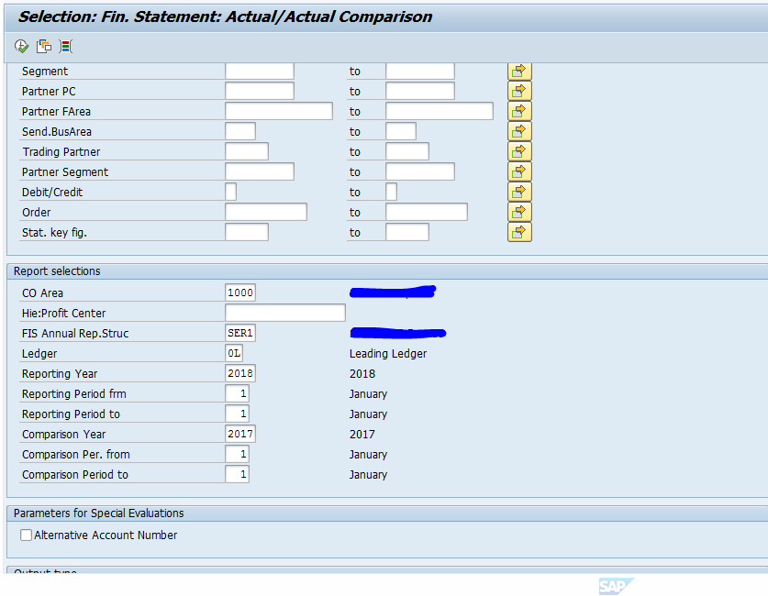
Report S_PL0_86000028
Input Screen

Slide 51
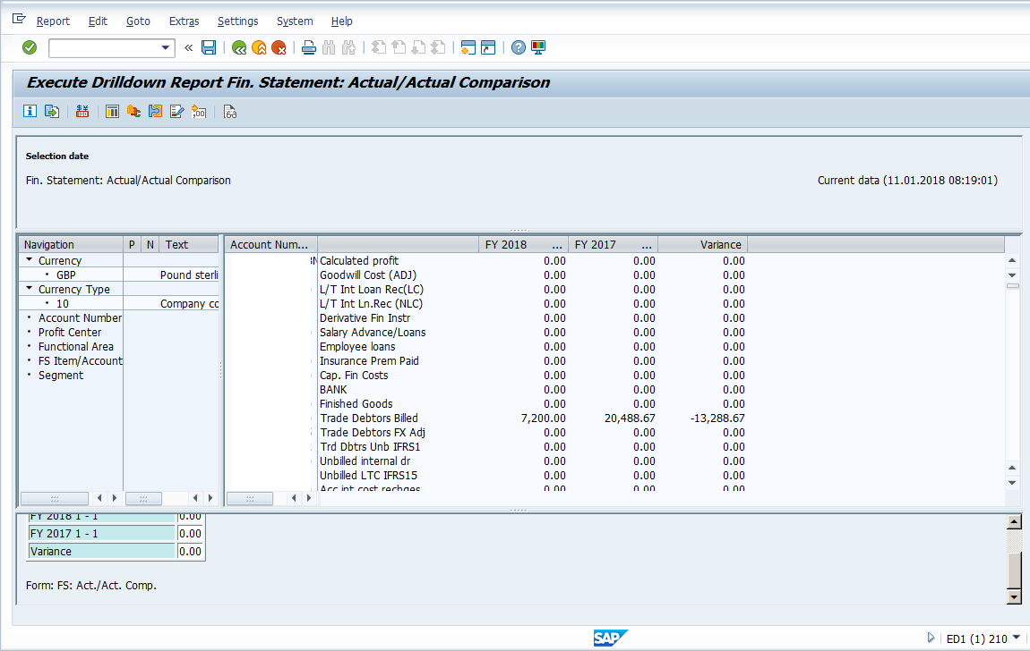
Output

Slide 52
Report S_ALR_87012249 - Actual/Actual Comparison for Year
Steps to execute the report
Use T-Code S_ALR_87012249 and hit enter key
Provide the following input parameters and execute the report to view the details
Company code
FIS annual rep. Structure
Currency type
Fiscal year
Classic drilldown report - Selected

Slide 53
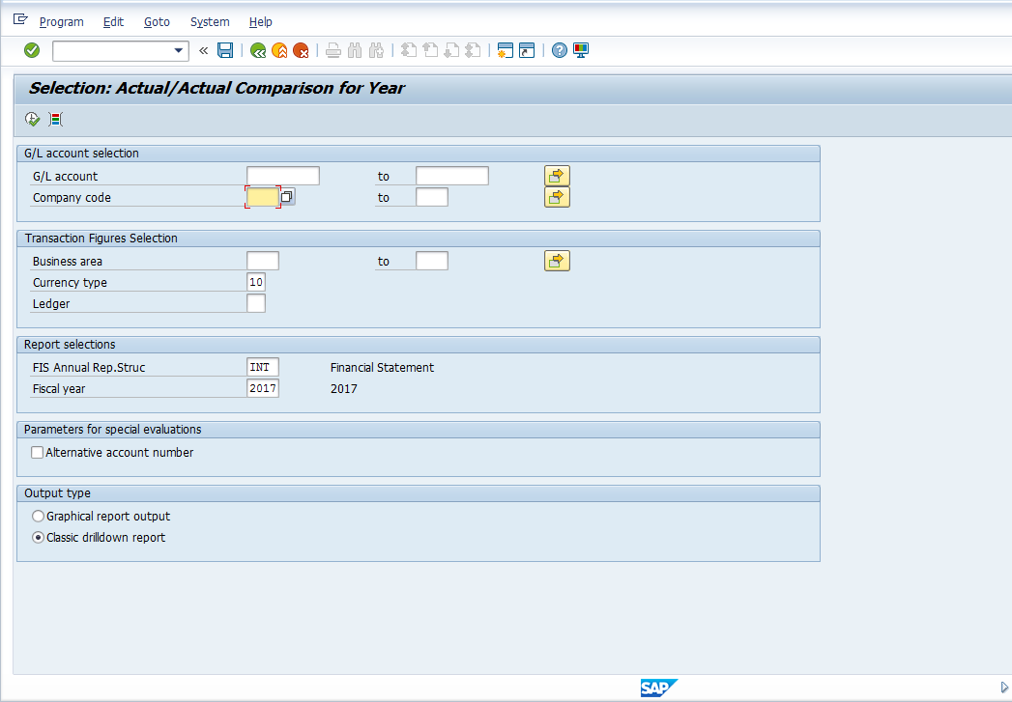
Report S_ALR_87012249 - Actual/Actual Comparison for Year
Input Screen

Slide 54
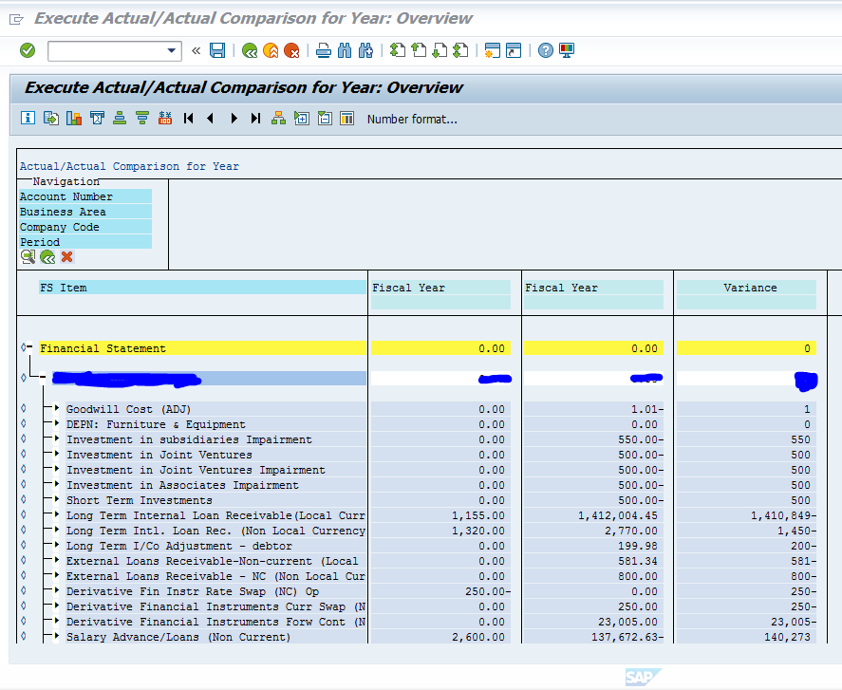
Output

Slide 55
Closing Activities
Overview of Closing Activities
Balance Confirmation
Value Adjustments
Regrouping
Financial Statement Versions
FI Year End Reports
Important FI tables

Slide 56
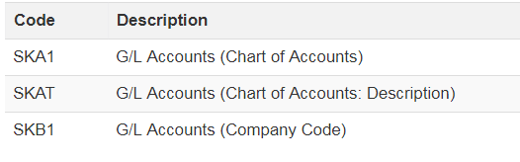
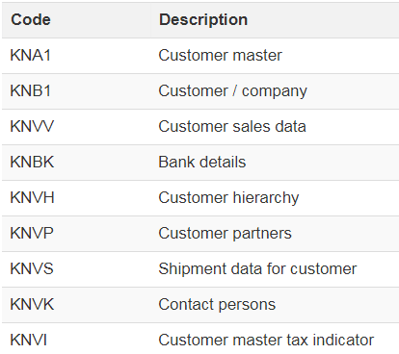
SAP FI – Important Tables
G/L Accounts - Master Data
Customer Master

Slide 57
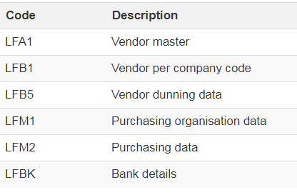

SAP FI – Important Tables
Vendor Master
Bank data

Slide 58
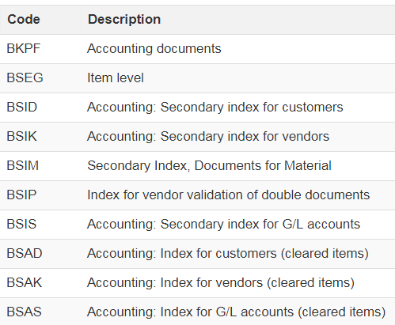
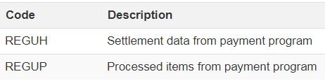
SAP FI – Important Tables
Accounting documents
Payment Run

